Slide 1
Automation Platinum Demo
Predictive decisioning
Introduction and overview

Slide 2
Demo overview
REMOVE THIS SLIDE BEFORE PRESENTING TO CUSTOMERS
Purpose of this deck | This deck is to be shown to customers to introduce and summarize the Predictive decisioning demo.
Scenario overview | The demo uses a customer call center example to illustrate how the Cloud Pak for Business Automation integrates machine learning with business rules to improve real-time decisions.
Product(s) in the demo | Cloud Pak for Business Automation; Cloud Pak for Data (machine learning capability)
Capabilities to be demonstrated | Decision management; Predictive analytics
Supported product version(s) | Cloud Pak for Business Automation 21.0.2; Cloud Pak for Data as a Service
IBM Technology Zone page | https://techzone.ibm.com/collection/platinum-demos-predictive-decisioning
Demo components
IBM TechZone-provided environment
SaaS
Decision management
Low-code development
Machine learning
Decision authoring
Decision runtime
Automation studio
Application designer
Predictive analytics authoring
Predictive analytics runtime
Cloud Pak for Business Automation on ROKS
Cloud Pak for Data as a Service

Slide 3
Demo overview
Scenario
SkyTalk’s call center agents use a PDF document to make customer retention offers. Because offers are not targeted, the company loses many of its most profitable customers - while retention costs skyrocket.
The company builds a business rules application to make real-time retention offers. However, the app can’t predict key retention factors like ‘customer lifetime value’ and ‘propensity to churn.’
The company creates machine learning models to do real-time calculations of customer lifetime value and propensity to churn. They build these models without needing data science skills.
The company uses the built-in integration between decision management and machine learning to generate targeted retention offers while the customer is on the phone with the call center agent.
Cloud Pak capabilities in the demo
Decision management
Integration with predictive analytics

Slide 4
Demo flow
As-is process
Automated decisions
Predictive models
Customer retention
offers are manually selected by call center agents
Create business rules to automate selection of retention offers
Use machine learning to predict customer churn and lifetime value
Call center
application
Integrated decisions
and predictions
Retention offers are generated in real time during call center conversations
Combine business
rules and predictions
to determine best
retention offer

Slide 5
Demo components
Decision management
Low-code development
Machine learning
Decision authoring
Decision runtime
Automation studio
Application Designer
Predictive analytics authoring
Predictive analytics runtime
Cloud Pak for Business Automation
Watson Machine Learning (in Cloud Pak for Data)

Slide 6
DEMO
Predictive decisioning

Slide 7
Key takeaways
Predictive decisioning demo
Predictive decisioning…
combines machine learning and business rules to make more insightful decisions
uses data to ensure decisions are made consistently in predictable situations
supports call center reps by providing “next best offers” in real time
Integrated machine learning predicts the likelihood of specific outcomes (e.g., customer churn, acceptance of cross-sell/upsell offers).
Decision automation turns predictive insights into specific actions companies can take to save time and improve profitability.
Low-code tools eliminate barriers that often keep business users from using data science to enhance business decisions.

Slide 9
Additional learning resources
Automation Decision Services: Key concepts
Automation Decision Services: Modeling decisions
Automation Decision Services: Getting started tutorial
Automation Decision Services: Integrating machine learning
Watson Machine Learning: AutoAI overview

Slide 10
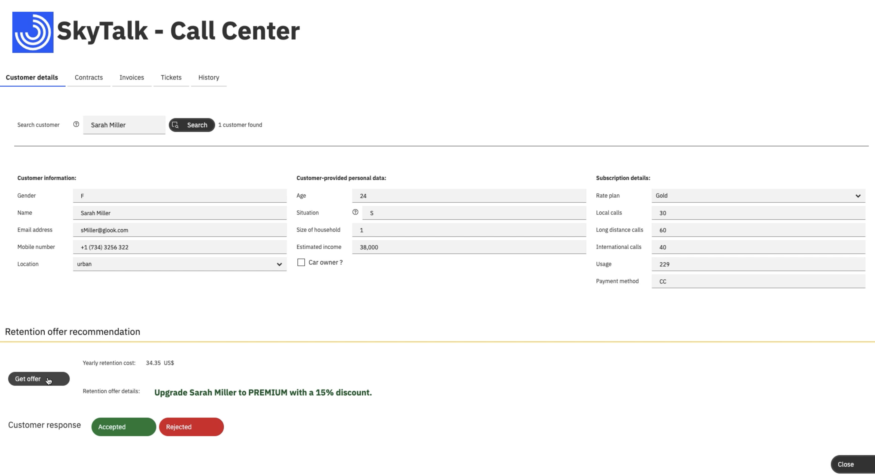
Demo architecture
Lifetime value prediction service
Lifetime value ML model
Retention decision service
ML provider
Churn prediction service
Churn ML model
SkyTalk Call Center application project
Customer retention decision project
Data CSV files
Low-code application building
Decision runtime
Decision authoring (business rules)
Watson Machine Learning
Cloud Pak for Business Automation
Cloud Pak for Data

